Slide 1


AUTOMATIC HAND SANITIZER
Under guidance of Mr. S.Tamilselvan Assistant Professor BIT
Sathy.
(7376211CS248
&PRAVEENRAJA.SK)
(7376211IT146 & HARIPRASAD.S) (7376211CS231 & NIKILANAND.S) (7376211CS166 & INDHUJA.J)

Slide 2
Abstract
So let’s get started. Here, we use to an ultrasonic sensor calculate the distance of our hand from the sensor. If the hand is close to the dispenser, Arduino will activate the pump and the sanitizer will be expelled out of the bottle through the tube.

Slide 3
Problem Statement Addressed
Hand is one of the media that could spread diseases, such as skin diseases, diarrhea and respiratory diseases such as Upper Respitory Tract Infection caused by germs or bacteria left on the hands after carrying out various activities, therefore cleaning hands is very important for everyone to prevent the spread of disease.

Slide 4
Existing Solution to the Problem Addressed
The automatic hand sanitizer is a smart device that is controlled by an Arduino microcontroller, in addition to working automatically this tool is also programmed to be able to adapt to user needs, this tool can be applied anywhere, such as in restaurants, hospitals, toilets , etc. Because this tool works automatically, our hands are more assured in cleanliness because users doesn’t need to touch the hand sanitizer lever to operate the hand sanitizer.

Slide 5
Proposed Solution to the Problem Addressed
we use an Ultrasonic distance sensor, Servo motor and Arduino board. here I am using Arduino Uno. You can also use any other microcontroller. When we place our hand in front of the distance sensor, it will help to the Arduino to measure the distance from the sensor to object (here the hand). if the object in the desired range, Arduino will write the servo to 180. Servo motor is mounded on the hand sanitizer bottle. And the trigger of bottle is connected to servo by a thread. When servo motor rotate, the trigger will press.

Slide 6
Project Work Plan
Step - 1
First I am going to create a sketch
Open Arduino IDE and open a new window.
Here I am using Servo motor. So we need to use the "Servo.h" library for better communication between Arduino and servo motor. Then we define the "echoPin" on digital pin 4 and "trigPin" on digital pin 5. And also declare the variable for calling Servo motor.

Slide 7
Project Work Plan
We need to declare two variables. First one is "duration". This is for store the total travel time of sound wave. And other is "distance", for store the calulated distance.
Step - 2
Now we need to program the setup part.
First set the attach pin of servo motor by Servo.attach() on the digital pin 3. Then set the echoPin as "INPUT" and trigPin as "OUTPUT" by using the keyword pinMode().
setup part is completed. Then loop part,

Slide 8
Project Work Plan
Step - 3
In void loop() part we need to read the total travel time of sound and calculate the distance.
Now we need to write the servo motor to 180 degree only when the distance is less than or equal to 5 cm. Else the servo position keep in 0 degree.
Then add a delay instruction for wait 500 millisecond for the next read.
The coding part is completed. You can get the complete code in attachment section.

Slide 9
Project Work Plan
Step - 4
Now we need to setup the circuit.
There is only one 5V female Header available in Arduino Uno. So, We need
to Joint three male to male jumber wire connect together. After that one
end of this jumber wire connect to Arduino board and other to Vcc of the
Servo Motor and Vcc of the HC-SR 05. There are two GND connects
available in Arduino Uno. So connect the one GND to GND of Servo motor
and other GND connect to GND of HC-SR 05. The electronic connection is completed.
Then take a thread and tie one end with trigger of the bottle and other end tied with arm of the servo motor. Mound the Servo motor on the bottle.
You can use 12V SMPS adapter to power the Arduino with the DC jack.
The hardware setup is completed.

Slide 10
Project Work Plan
#include<Servo.h> #define echoPin 4
#define trigPin 5 Servo Myservo; int long duration; int distance; void setup()
{
Myservo.attach(3); pinMode(echoPin,INPUT); pinMode(trigPin,OUTPUT);
}

Slide 11
Project Work Plan
void loop()
{
digitalWrite(trigPin,LOW); delayMicroseconds(2); digitalWrite(trigPin,HIGH);
delayMicroseconds(10); digitalWrite(trigPin,LOW); duration=pulseIn(echoPin,HIGH); distance=(duration*0.034/2);
if(distance<=5)
{
Myservo.write(180);
}
Else
{
Myservo.write(0);
}
delay(500);
}

Slide 12
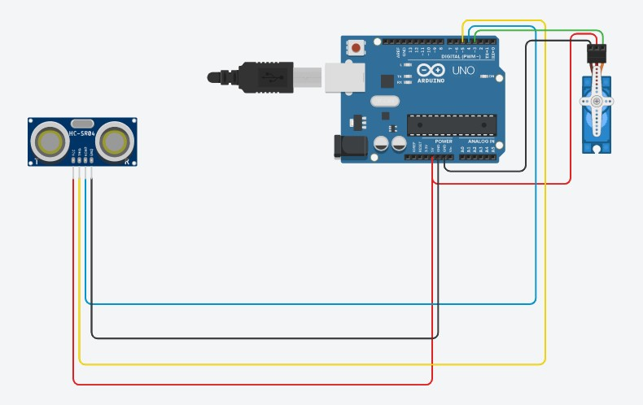
Block Diagram and Circuit Diagram
(Detailed Block Diagram explaining the input, processing units & output need to be included)

Slide 13
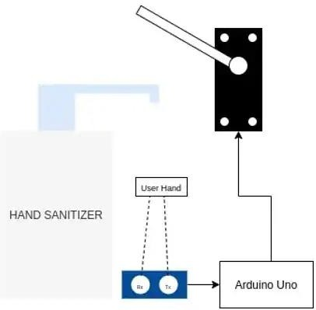
Flow Chart

Slide 14
Effective utilization of the Modern Tool & Cloud
Implementation, Testing & validation and usage of website or App or anything
Name of the cloud platform & reason for choosing the same need to be explained

Slide 15
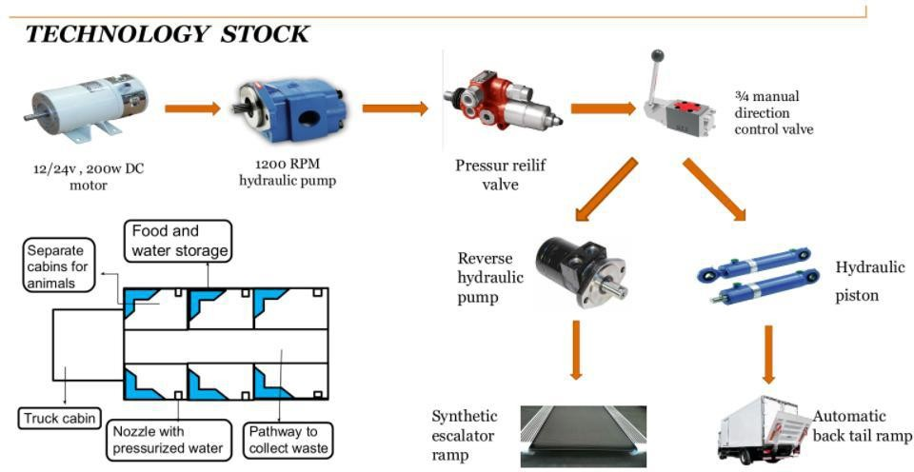
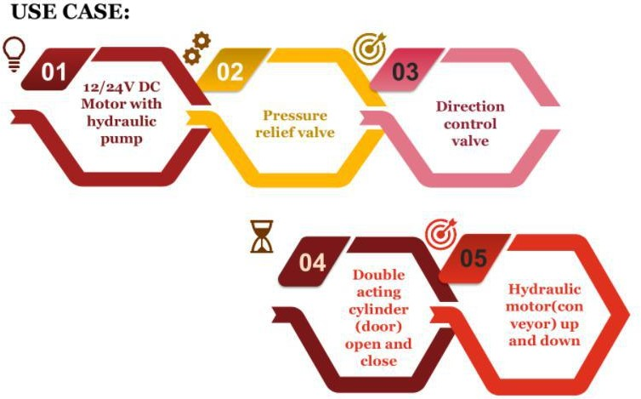
Technology stack & use case

Slide 16
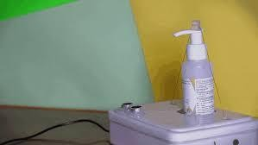
Sample Output

Slide 17
Analysis of Results & Discussions
ADVANTAGE :
Automatic. The first and foremost advantage of an automatic sanitizer dispenser is that it
provides a truly touchless experience. ...
Easy to use. ...
Delivers a standard dose. ...
Eliminates a contact point. ...
Modern appearance. ...
Batteries wear down fast. ...
Price factor. ...
Maintenance.
DISADVANTAGE :
There is scepticism that an automatic dispenser is high maintenance. As the sanitizer dispenses automatically, it gets clogged in places, which requires timely cleaning. This also makes the place dirty and unhygienic.

Slide 18
Cost Benefit Analysis (List of Components / Service Used)
(Budget)
S.No | Component Name | Specification (IC number or Range or Value) | Unit Cost | Total Cost
1. | Arduino uno | 14 | 999 | 999
2. | servo motor | 5 | 650 | 650
3. | ultrasonic sensor | 5 | 349 | 349

Slide 19
Working video Link (If available)
https://create.arduino.cc/projecthub/aakash11/a utomatic-hand-sanitizer-using-arduino-2924ad

Slide 20
References
[1] Rini, Eka P., Nugraheni, Estu R., 2018, Journal of Pharmaceutical Science and Clinical Research 3-1-18
[2] Pahl, G., Beitz, W., 2007, Engineering Design: A Systematic Approach (Germany: Third edition)
[3] Irawan, A.P., Fediyanto, Tandi, S., 2006, Proceedings-Ergo Future 2006 pp. 337-341
(sample references, the same format should be followed throughout)

